Slide 1
Lesson objective
Title: Area review
Aim – be able to:
Calculate the perimeter and area of common geometric shapes.
Plan:
Review conversions of distance and area.
Review calculating the areas of common shapes.
Area in real life
Notes:
Work sheet available from shareddrive, strands, measurement Year 8 perimeter and area

Slide 2
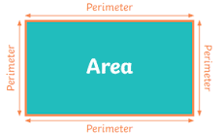
Perimeter
Perimeter – the distance around the outside of a shape.
Area – the amount of space taken up by a 2D shape.
Area

Slide 3


Slide 4
Area
Consider a square that is 1cm by 1cm. It has an area of 1cm².
What is it’s area in mm²?
1cm² = 100mm²
1cm
10mm
?
A = 1cm²
A = 100mm²
1cm
10mm

Slide 5

Area
Using this logic, you work out the rate of conversion from m² to cm²?
$1m=100cm$
$1m2 = 10000cm2$

Slide 6
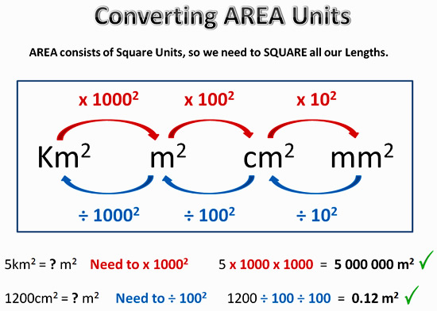

Slide 7
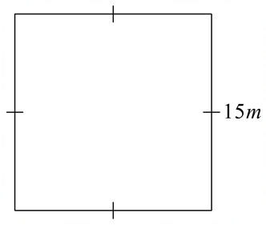
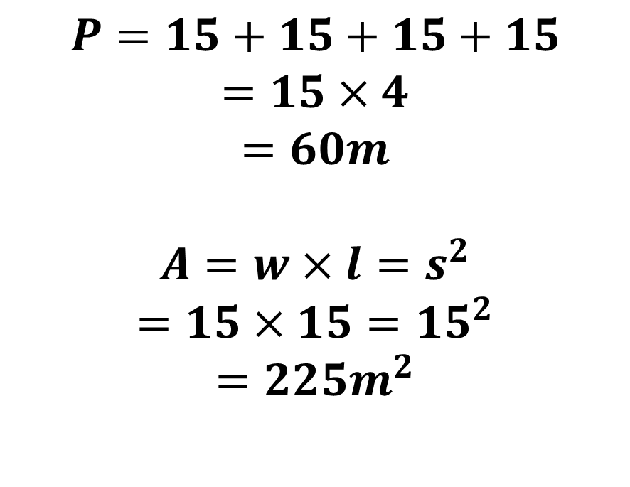
What is the perimeter and area of this shape?
$$P=15+15+15+15$$
$$=15×4$$
$$=60m$$
$$A=w×l=s^{2}$$
$$=15×15={15}^{2}$$
$$=225m^{2}$$

Slide 8
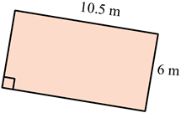
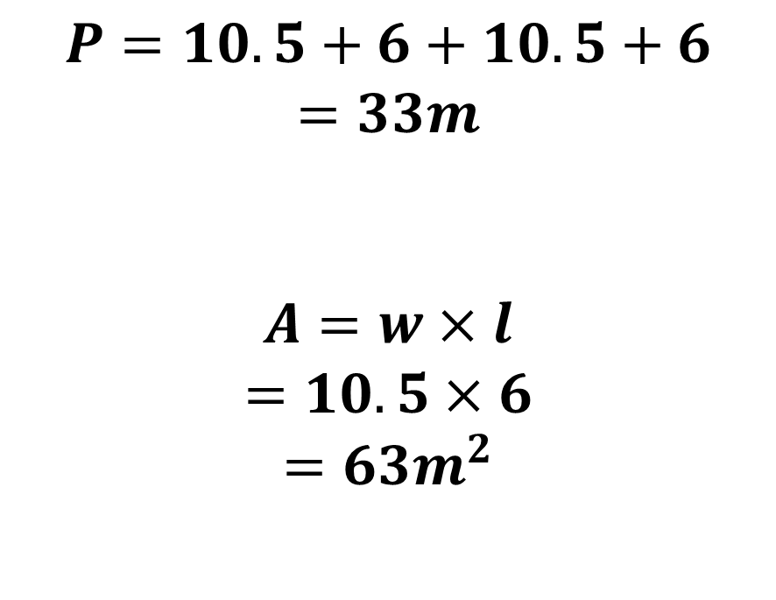
What is the perimeter and area of this shape?
$$P=10.5+6+10.5+6$$
$$=33m$$
$$A=w×l$$
$$=10.5×6$$
$$=63m^{2}$$

Slide 9
Area of Triangles
Area of a triangle = ½ x base x height
= ½bh
Height
Base

Slide 10
Base and height are always perpendicular to each other
Perpendicular – “at right angles to”

Slide 11

Area of Triangles
Area =$\frac{base × height}{2}=\frac{1}{2}×base×height=0.5×base×height=0.5bh$
base
height
height
height
base
base

Slide 12
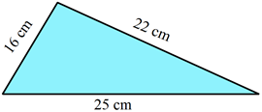
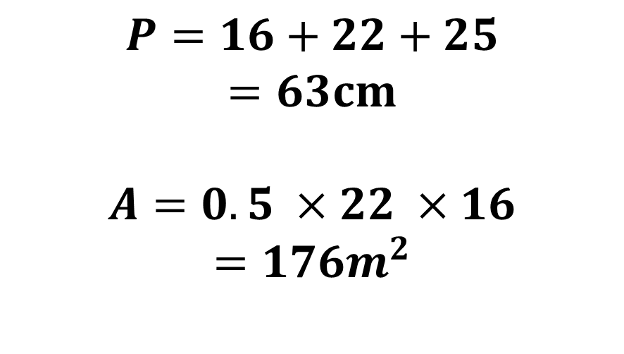
What is the perimeter and area of this shape?
$$P=16+22+25$$
$$=63cm$$
$$A=0.5 ×22 ×16$$
$$=176m^{2}$$

Slide 13
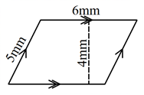
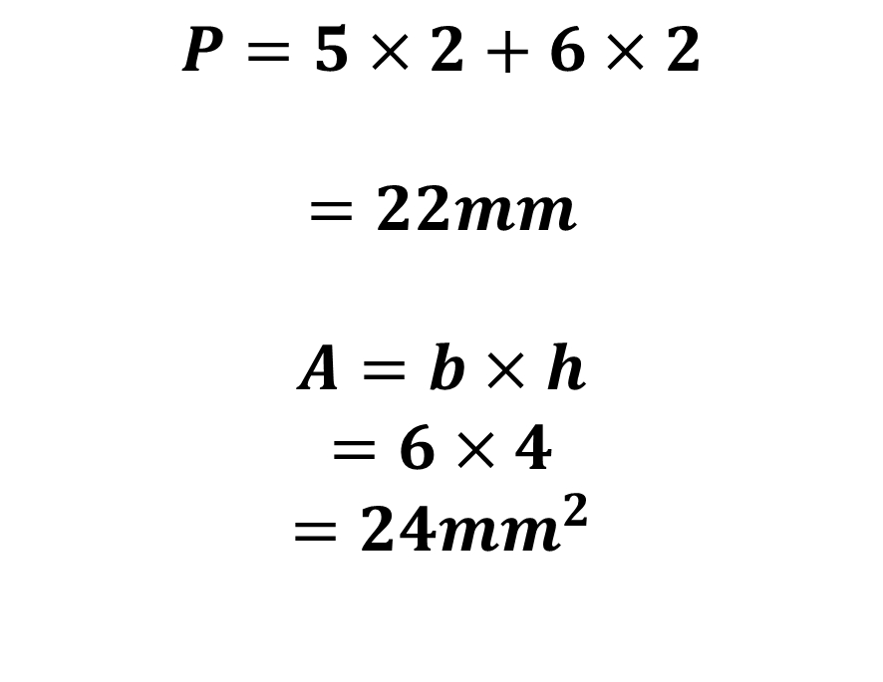
What is the perimeter and area of this shape?
$$P=5×2+6×2$$
$$=22mm$$
$$A=b×h$$
$$=6×4$$
$$=24{mm}^{2}$$

Slide 14
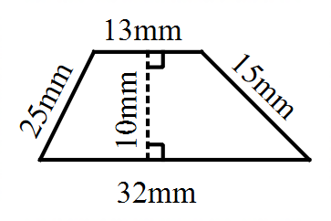
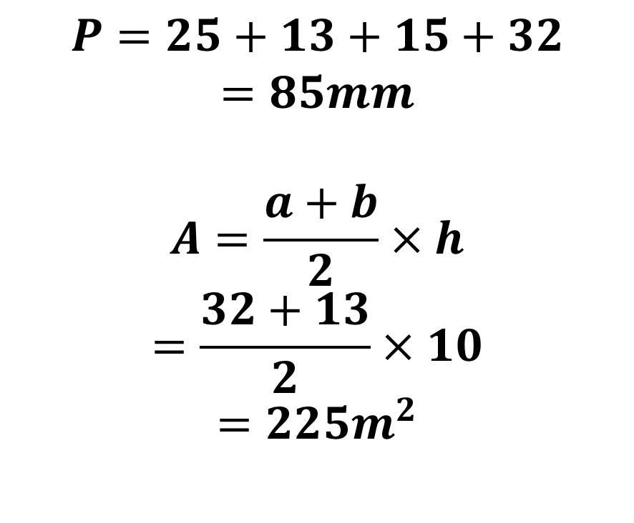
What is the perimeter and area of this shape?
$$P=25+13+15+32$$
$$=85mm$$
$$A=\frac{a+b}{2}×h$$
$$=\frac{32+13}{2}×10$$
$$=225m^{2}$$

Slide 15

3
Answers:
140cm²
56cm²
180cm²
196cm²
132cm²
240cm²
330cm²
72cm²
72cm²
180cm²
140cm²
240cm²
225cm²
2
1
15cm
14cm
8cm
4
10cm
7cm
12cm
14cm
5
6
7
9cm
12cm
12cm
11cm
15cm
11cm
30cm
20cm
9
8
10
14cm
12cm
18cm
9cm
16cm
12cm
20cm
12
11
8cm
13
14cm
25cm
15cm
14cm
12cm
15cm
12cm
16cm

